Slide 1
narrating Detroit: Counter Narratives & the Circle of Human Concern
Professor john a. powell
Haas Diversity Research Center, Executive Director
and The Robert D. Haas Chancellor’s Chair in Equity and Inclusion
University of California, Berkeley

Slide 2
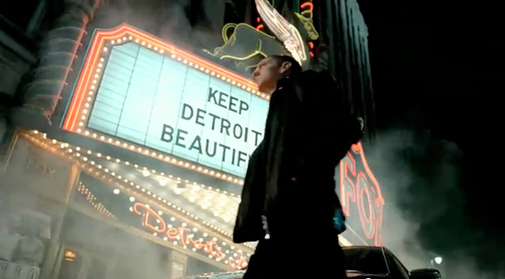
“Imported from Detroit”
http://www.youtube.com/watch?v=SKL254Y_jtc

Slide 3
“Imported from Detroit”
“I got a question for you. What does this city know about luxury? What does a town that’s been to hell and back know about the finer things in life? Well, I’ll tell ya. More than most.
You see, it’s the hottest fires that make the hardest steel. Add hard work and conviction. And the know-how that runs generations deep in every last one of us. That’s who we are. That’s our story.

Slide 4
Now it’s probably not the one you’ve been reading in the papers. The one being written by folks who have never even been here and don’t know what we’re capable of. Because when it comes to luxury, it’s as much about where it’s from as who it’s for.
Now we’re from America. But this isn’t New York City. Or the Windy City. Or Sin City. And we’re certainly no one’s Emerald City.
This is the Motor City. And this is what we do.”

