Slide 1
Corporate Misalignment &
the Circle of Human Concern
Professor john a. powell
Haas Diversity Research Center, Executive Director
and The Robert D. Haas Chancellor’s Chair in Equity and Inclusion
University of California, Berkeley

Slide 2
Overview
Public/Private?
Corporate Prerogative
Circle of Human Concern

Slide 3
Public vs. Private?

Slide 4

Public vs. Private?
Distinction blurred
Examples:
Private colleges
Housing as a private good complemented by government policies
  GI Bill
  Expansion of highway system
  Fannie Mae and Freddie Mac

Slide 5
Public vs. Private?
Civil Rights Act of 1875 – equal treatment in “public accommodations”
  Citizenship clause and membership in political community
Overturned by Supreme Court eight years later
  “The wrongful act of an individual, unsupported by any such authority, is simply a private wrong, or a crime of that individual”

Slide 6
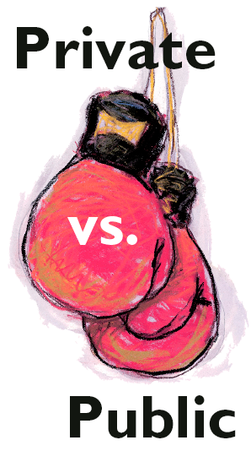
Public vs. Private?
Private vs. public discrimination
Tension between addressing state action vs. de facto conditions produced by “private” decisions
Source: CSUN Daily Sundial Newspaper

Slide 7
Redefining Domains of Space

Slide 8
Non-Public/Non-Private Space
Public space is a domain of power for citizens. Private space is understood to be maximum freedom and minimum government.
This space is misleading for individuals who enjoyed neither public rights nor private freedom Historically, women and slaves inhabited he non-public/non-private sphere.
  Slaves enjoyed no public rights nor private freedoms
  Women were denied property and standing rights. Home was ‘man’s castle,’ women’s dungeon.
Today, immigrants, incarcerated, disabled, and other marginalized groups inhabit this space.

Slide 9
The Misalignment of Power
The issue isn’t public/private, but public/corporate
Expansion of corporate prerogative
Corporate space diminishes public & private space
Private

Slide 10
Characteristics of different spaces
This is the least ideal combination

Slide 11
Corporate Prerogative

Slide 12
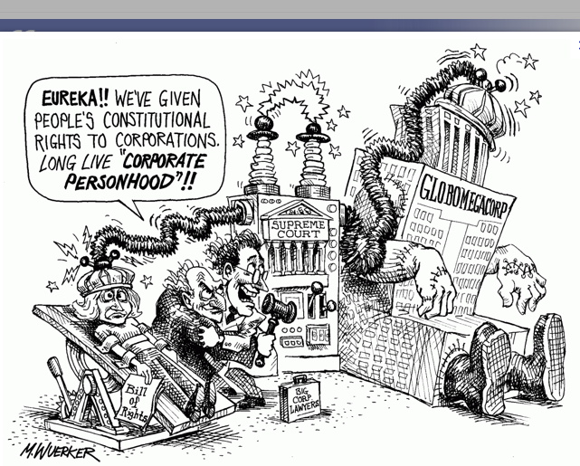
Expansion of Corporate Domain
When and how did the expansion of the corporate domain occur?

Slide 13
Expansion of Corporate Domain
This was the Gilded Age.
  Lochner decision -- The Courts repeatedly overturned state and federal labor and minimum wage laws, and economic regulations.
  Court said that legislatures couldn’t regulate the economy – reminiscent of Tea Party today.
  Lochner era was also Jim Crow era – state discretion to discriminate.
Populist and Progressive fought Corporate power and lost.
  Strategy was not racially inclusive

Slide 14
Expansion of Corporate Domain
The purpose of the 14th Amendment, known as equal protection, was really focused on citizenship
Justice Miller, “We doubt very much whether any action of a State not directed by way of discrimination against the Negroes as a class, or on account of their race, will ever be held to come within the purview of this provision.”

Slide 15
Corporate Personhood
Until 1886, corporations were not considered persons. They were considered artificial creations of their owners and state legislatures.
Corporate attorneys used the 14A to argue that States, which had chartered them, were restrained from exercising powers over them.
  This began in the 1870s and culminated in Santa Clara (1886).

Slide 16
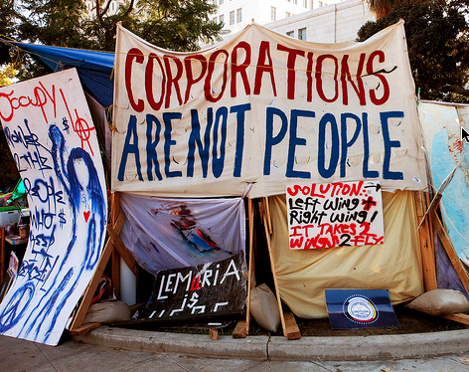
Legal Fiction
Slavery is the legal fiction that a person is property. Corporate personhood is the legal fiction that property is a person.

Slide 17
Corporations, Race &
14th Amendment
Just as the Court extended standing rights to corporations, it denied those rights to blacks.
Between 1890 and 1910, just 19 cases brought under the 14th Amendment dealt with the rights of descendents of slaves, whereas 288 dealt with the rights of corporations.
In 1937, Justice Black noted that less than ½ of 1% of the cases under the 14th had anything to do with blacks and more than 50% was for the protection of Corporations.

Slide 18
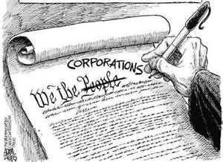
The Reconstruction Court
The doctrine of Corporate Personhood originates from the same cloth as Plessy v. Ferguson’s doctrine of ‘Separate But Equal’:
  The same textual provisions
  The same judicial actors
  The same judicial philosophy
  The same dynamic

Slide 19
Corporate Prerogative & Civil Rights
The Gilded Age/Jim Crow decisions are part of a common social structure
  The exercise of social power through property rights continues to mask the concomitant disempowerment of people of color.
  The Reconstruction Amendments have been hijacked to expand corporate prerogative and narrow the rights of marginalized through a variety of legal doctrines, including corporate personhood, and through a discourse of public/private.

Slide 20
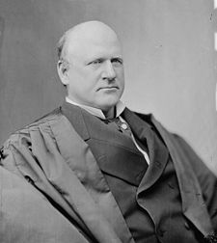
It was said in argument that the statute of Louisiana does not discriminate against either race, but prescribes a rule applicable alike to white and colored citizens.
Every one knows that the statute in question had its origin in the purpose, not so much to exclude white persons from railroad cars occupied by blacks, as to exclude colored people from coaches occupied by or assigned to white persons. No one would be so wanting in candor as to assert the contrary. -- Dissent in Plessy
Justice J. M. Harlan, Dissenting
It is plain that this statute was enacted in order to protect the physical wellbeing of those who work in bakery and confectionery establishments. It may be that the statute had its origin, in part, in the belief that employers and employees in such establishments were not upon an equal footing, and that the necessities of the latter often compelled them to submit to such exactions as unduly taxed their strength. -- Dissent in Lochner

Slide 21
Corporate Prerogative
Thus we can look at each one of those actions on behalf of corporations as a transfer of both economic and human rights from black people to those who control large-scale capital.
Since Bakke, the Court has endorsed a counter-attack by business against the assertion of human rights by the public in general, and people of color and women in particular.

Slide 22
Citizens United
In the 1970s, Justice Powell argued on behalf of corporate speech.
  Even the conservative Justice Rehnquist saw the danger of protecting the free speech rights of entities that control vast amounts of economic power and enjoy the ‘blessings of potentially perpetual life and limited liability.”
  The dissenting Justices warned of the potentially distorting influence of corporate campaign contributions – protected as speech – in a democracy. These fears have now been realized and the full logic of corporate personhood exposed.
In Citizens United v. FEC in 2010, the Court held that corporations enjoy unbridled First Amendment rights to spend independent money on political campaigns.

Slide 23
Corporate Misalignment
One aspect of misalignment was the repeal of Glass-Steagall, a 1933 law which separated investment banks from commercial banks.
This law prevented commercial banks from gambling ordinary deposits on risky financial instruments and speculation.
This not only led to a rash of mergers between investment and commercial banks, but created the “Too big to fail.” So that when risky investments fail, taxpayers have to bail out the banks to save depositors and the financial system.

Slide 24
Recent Financial Fraud
Barclay’s LIBOR Rate Manipulation (reported June, 2012)
HSBC’s Money Laundering for Mexican Drug Cartels (Reported July, 2012)
USA v. Carallo: Wall Street & GE Capital Municipal Bond Rigging

Slide 25
LIBOR (London Interbank Offered Rate) Scandal
Libor is one of the most important rates in the economy. It’s the rate that banks borrow from each other. It determines the rate of savings of millions of people, as well as the rate paid on mortgages and car loans.
In June, 2012, regulators fined Barclays over $400 million for rate fixing and rate manipulation.

Slide 26
HSBC Scandal
HSBC recently revealed that it participated in the laundering of money for Mexican drug cartels with lax standards.

Slide 27
USA v. Carollo
The Department of Justice prosecuted Wall Street defendants for bid rigging the prices paid by banks to bond issuers were reduced (to the detriment of the local governments who issued those bonds).
The banks – JP Morgan/Chase, BOFA, UBS, etc colluded to rig public bids on municpal bonds to lower the returns that towns earned on those investments.

Slide 28
Globalization
Globalization can encourage corruption. The Foreign Corrupt Practices Act of 1977 stopped the rampant practice of bribing foreign officials.
Similar regulations are needed today. Our financial markets are global, and without global regulation, we cannot reign in bad behavior.

Slide 29
Sandy Weill on Squakbox
Sandy Weill, former CEO of Citigroup, recently called for a return of Glass-Steagall
http://www.youtube.com/watch?v=mZ_fvnN9P2Q

Slide 30
Dodd-Frank
One of the provision of Dodd-Frank is to prevent “too big to fail.” However, Dodd-Frank never goes as far as Glass-Steagall did in separating commercial and investment banking.
The closest it gets is the so-called Volcker Rule, proposed by former Federal Reserve Chairman Paul Volcker, which bans banks from risky speculative trading with federally-insured money. The Volcker Rule was enacted as part of Dodd-Frank in 2010 and were scheduled to be implemented on July 21st, 2012, but the are being fought and litigated by legislators, regulators and bank lobbyists.

Slide 31
Circle of Human Concern

Slide 32
The Circle of Human Concern
What are the effects of this misalignment of power?
How does it impact where people are situated within structures?
Differential positioning in structures is a way to understand who inhabits the circle of human concern as a full member and who is pushed out of it

Slide 33
Effects of Misalignment
Circle of Human Concern
Non-public/non-private

Slide 34
Effects of Misalignment
Circle of Human Concern
Citizens
Felons
Elderly
Mothers
Children
Undocumented
Non-public/non-private Space

Slide 35
