Slide 1


Fisher v. Texas and the Future of Affirmative Action
john a. powell,
Director,
Haas Institute for a Fair and Inclusive Society
October 18, 2012

Slide 2
Overview
The Importance of Race-Conscious Admissions
A Brief History of Race-Conscious Admissions
The Facts of Fisher v. Texas
Possible Outcomes in Fisher
Post-Fisher Advocacy

Slide 3

The Importance of Race-Conscious Admissions

Slide 4
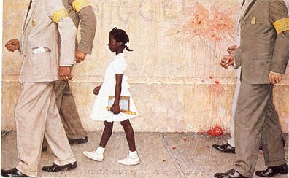
Segregation
& Education
  Hyper-segregated: About 1 in 6 Black and Latino students are hyper-segregated, and attend schools in which the student body is 99-100% minority.
  Intensely segregated: Nearly 40% of Black and Latino students attend ‘intensely segregated schools,’ in which 90-100% of the students are minority.
  Whites also isolated: The typical white student attends a school that is 80% white, which is much higher than their share of overall public school enrollment.

Slide 5
Race and Concentrated Poverty
  3 of 4 persons living in concentrated poverty are Black or Latino even there are more poor Whites in absolute numbers.
      Concentrated Poverty: neighborhoods where over 40% of residents live below the Federal Poverty Line
  Only 1/5 of the schools with less than 10% black or Latino populations are high poverty schools.

Slide 6

Higher Education
  Racial breakdown of college students who received college degrees in 2003:
    Whites - 70%
    Blacks - 8.7% (despite being 13% of the population)
    Hispanics - 6.3%
    Asians - 6.2%
  74% of students at the 146 most selective four-year colleges and universities in the U.S. came from the top socioeconomic status quarter of American families; 3% from the bottom quarter

Slide 7

Challenges to Diversity -Testocracy
Standardized tests do not measure intelligence. They measure developed skills.
Standardized Tests like SAT, LSAT, etc are poor predictors of student performance.
Standardized tests measure family, and especially intergenerational wealth.

Slide 8
A Brief History of Race-Conscious Admissions

Slide 9

Regents of the University of California v. Bakke (1978)
Allan Bakke, a white male, applied to Medical School of the University of California Davis, and was rejected.
UC Davis had two admissions tracks: general admissions and special admissions for disadvantaged students of a “minority group.”
    ‘Special admissions’ set aside 16-100 seats.
Allan Bakke sued arguing that but for the special admissions track, he would have been admitted.

Slide 10
The Court:
Struck down the plan as a violation of the EPC, holding that:
All racial classifications are subject to strict scrutiny.
Remedying Societal Discrimination is not a compelling interest.
Ethnic/racial diversity is one element out of many that a university may consider in attaining a heterogeneous student body.

Slide 11
What is Strict Scrutiny?
Strict Scrutiny is a legal standard and a two pronged test. It is the highest level of judicial scrutiny for constitutional review.
To satisfy this standard, racial classifications are constitutional only if they:
    1) Serve a compelling governmental interest
    AND
    2) Are narrowly tailored to serve that interest

Slide 12
Why Strict Scrutiny?
Strict Scrutiny serves two primary goals:
  A “Smoking Out” Function: strict judicial scrutiny permits an inquiry into the interests at issue, without presuming a benign motive.
  Cost/Benefit Function: The EPC protects individuals, not groups. Strict Scrutiny balances the government interests with the costs to individuals.

Slide 13

Gratz v. Bollinger (2003)
Petitioners, Michigan residents and Caucasian, applied for admissions to the University of Michigan’s College of Literature, Science, and Arts, and were denied admission.
Applicants who were members of an underrepresented minority group were awarded 20 points (on a 150 point scale).
Petitioners filed suit alleging discrimination on the basis of race in violation of the EPC and Title VI.

Slide 14

The Court held...
The admissions plan was unconstitutional because:
    The 20 point bonus undermined individual consideration because minimally qualified applicants would then be automatically accepted.
    The 20 points were awarded solely on one consideration: membership in an under-represented minority group.
    Being automatically admitted precludes consideration of other individual characteristics.

Slide 15
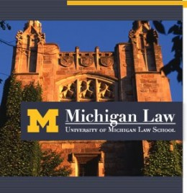
Grutter v. Bollinger (2003)
The Court held that:
The University of Michigan Law School had a compelling government interest in attaining a diverse student body.
The admissions program was narrowly tailored and thus did not violate the EPC.

Slide 16
What was the Court’s reasoning?
The Court found that the benefits from diversity are substantial:
  Breaks down racial stereotypes
  Promotes cross-racial understanding
  Creates livelier, more spirited, and enlightening classrooms
  Prepares students for diverse workforce and professional life
  Prepares students for citizenship

Slide 17
Narrow Tailoring Requirements
Program cannot use a “quota”
Race cannot be a defining feature of an applicant’s application: individualized, holistic review must be given
Serious, good faith consideration of workable race-neutral alternatives
No undue harm to any member of any racial group
Time Limited

Slide 18
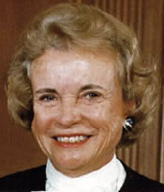
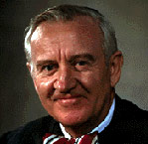
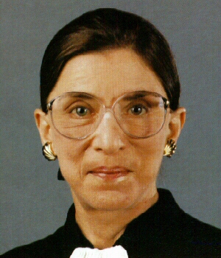
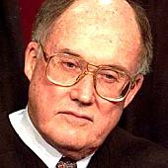
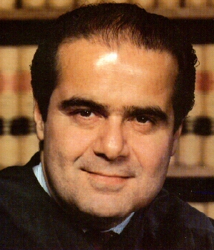
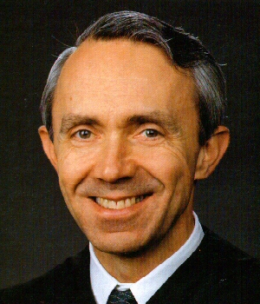
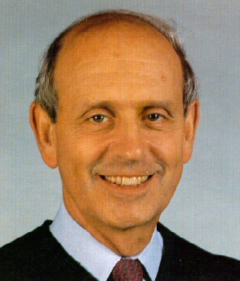
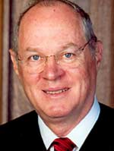
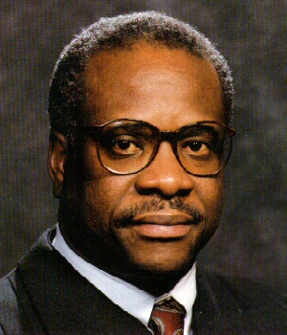
Court Composition in Grutter and Gratz

Slide 19

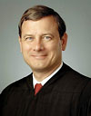
Changing Composition of the Court
2006: Justice Alito replaces Justice O’Connor
Justice Kennedy is the Critical Vote

Slide 20
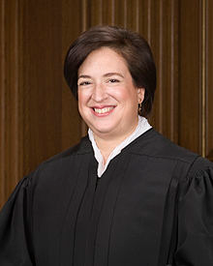
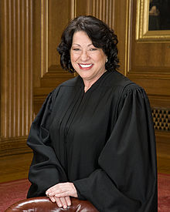
Changing Composition of the Court
2009: Justice Sotomayor replaces Justice Souter 2010: Justice Kagan replaces Justice Stevens (Justice Kagan recused herself from Fisher)
Justice Kennedy is still the Critical Vote

Slide 21
Justice Kennedy is Key
Justice Kennedy dissented in Grutter, but agreed with Justice O’Connor’s opinion that promoting diversity in higher education is a compelling governmental interest that justifies the use of race in admissions.
However, Justice Kennedy (as in Grutter) is likely to hold that the UT plan is NOT narrowly tailored.

Slide 22
Justice Kennedy: Narrow Tailoring (Grutter)
The narrow fluctuation band raises an inference that the Law School subverted individual determination.
    From 1995-1998 :
      The percentage of enrolled minorities fluctuated only by 0.3% from 13.5% to 13.8%
      The number of minority students to whom offers were extended varied by just 2.2% from 15.6% to 13.4%
Checking of daily reports undermined individual determination
    Daily Reports informed UT personnel whether they were short of assembling a critical mass of minorities
    “The bonus factor of race…then became divorced from individual review.”

Slide 23


Fisher v. Texas
The Future of Affirmative Action

Slide 24
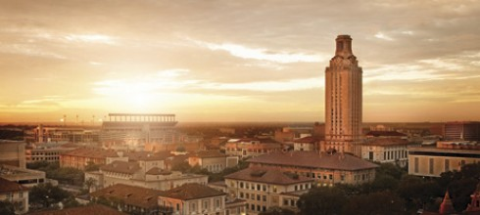
The Facts
Abigail Fisher, a white female, was denied admission to the University of Texas, and did not qualify for automatic admissions under the 10% Law.
The University of Texas has two admissions pools:
    Individuals automatically admitted through the 10% law
    A holistic admissions procedure that looks at the race of the individual applicant (ala Grutter).

Slide 25

The Texas-Ten Percent Plan
Guarantees admission to the University of Texas – the state’s flagship university -- for every student who graduates in the top 10% of their graduating class
Relies on patterns of residential segregation to generate diversity
Caused a split between conservative rural representatives and conservative suburban legislators
    Some counties in West Texas had never sent a high school graduate to the University of Texas.

Slide 26
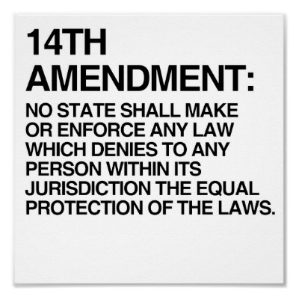
Fisher v. Texas
Ms. Fisher sued Texas arguing that the use of race in undergraduate admissions violates the equal protection clause of the 14th Amendment.
    She argues she had better credentials than minority applicants that were admitted.
    She also argues that the success of the 10% plan in generating student body diversity at UT renders the additional race-conscious procedure unnecessary.

Slide 27
UT Enrollment v. State Demographics
Race | University of Texas | State Demographics
White, Non-Hispanic | 50.4% | 45.3%
Asian | 17.9% | 4.4%
Hispanic/Latino | 20.0% | 37.6%
Black | 4.6% | 12.6%

Slide 28

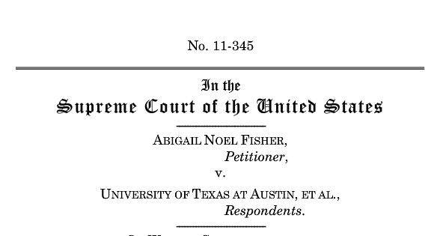
Possible Outcomes in Fisher v. Texas

Slide 29
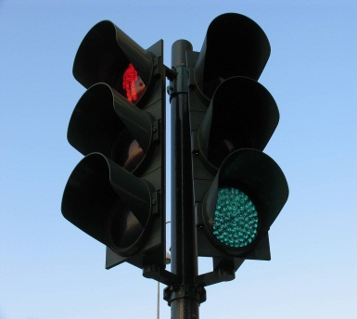
Possible Outcomes:
Worst Case Scenario: The Court strikes down UT’s admissions policy, and overturns Grutter in the process.
Narrow Ruling: The Court strikes down UT’s admissions policy, but under the Grutter/Bakke standard, preserving race-conscious admissions when proven necessary and narrowly tailored.
Best Case Scenario: The Court Upholds the UT Admissions Policy.
Possible, but not likely: The Court rules it does not have jurisdiction because Ms. Fisher does not have standing.

Slide 30
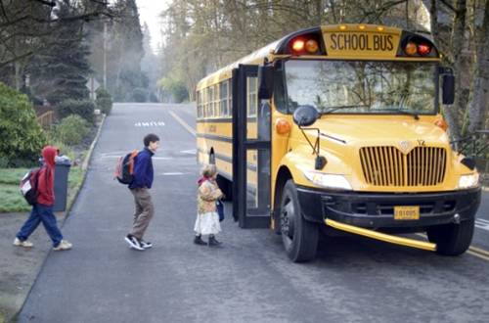
Post-Fisher Possibilities

Slide 31
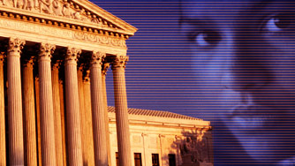
Post-Fisher Planning
Court upholds UT’s plan
    Universities can rely on race-based admissions policies with greater confidence.
Or
Court strikes down UT’s plan under Grutter or overturns Grutter…

Slide 32
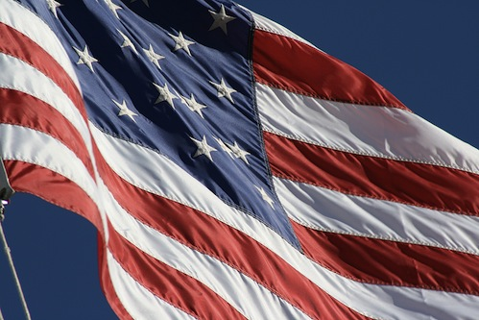
Post-Fisher Possibilities:
Geographic diversity
Socio-economic diversity
Preference for racially isolated school applicants
Diversity capital
Opportunity Enrollment
Targeted recruitment from minority schools
Reduce reliance on SAT/ACT

