Slide 1


Racial Integration &
Educational Opportunity
Professor john a. powell
Haas Diversity Research Center, Executive Director
and The Robert D. Haas Chancellor’s Chair in Equity and Inclusion
University of California, Berkeley

Slide 2
Presentation Overview
What is the problem with segregation from opportunity?
What is integration?
Why is it important? How do we build support for it?
How do we effectively integrate?

Slide 3

The Problem of Segregation
On Inequality, Democracy, and the Opportunity Gap

Slide 4
The Effect of Segregation on Inequality and Democracy
“Segregation of social groups is a principal cause of group inequality.”
“Segregation also undermines democracy”
“If segregation is a fundamental cause of social inequality and undemocratic practices, then integration promotes greater equality and democracy. Hence, it is an imperative of justice.
Elizabeth Anderson (2010), The Imperative of Integration
Notes:
Notes: Segregation “isolates disadvantaged groups from access to public and private resources, from sources of human and cultural capital, and from the network social networks that govern access to jobs, business connections, and political influence”
“Democratic political institution should be equally responsive to the interests and concerns of, and equally accountable to, all citizens. Segregation impedes the realization of this ideal and these principles.”

Slide 5
Historical Trends:
Segregation and the Opportunity Gap
“As public schools became more desegregated, beginning in the 1960s, the achievement gap narrowed”
“As school segregation increased again, beginning around 1990, progress in closing that gap ground to a halt.”
“Blacks' biggest gains were in the Southern states, where the effects of desegregation were greatest.”
David Kirp, “The Widest Achievement Gap,” http://www.nationalaffairs.com/publications/detail/the-widest-achievement-gap

Slide 6
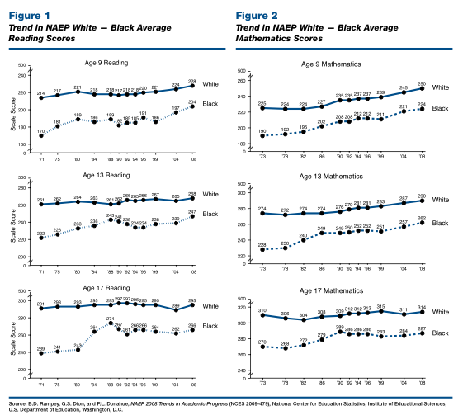
Historical White – Black Opportunity Gap
(Testing from 1970s – 2000s)
Educational Testing Service, http://www.ets.org/Media/Research/pdf/PICBWGAP.pdf

Slide 7
Beyond Testing
For children in segregated schools, the opportunity gap includes the following:
Schools are less likely to offer college- preparatory classes
Have higher rates of teachers’ teaching out of subject areas
Have greater teacher turnover
Have lower test scores

Slide 8
Remedying the
Racial Opportunity Gap
“We cannot remedy the large racial achievement gaps in American education if we continue to close our eyes to the continued racial segregation of schools, owing primarily to the continued segregation of our neighborhoods.”
Richard Rothstein, Economic Policy Institute
http://www.epi.org/blog/segregation-black-white-achievement-gap-romneys/

Slide 9
Race, Place &
Opportunity Structures

Slide 10


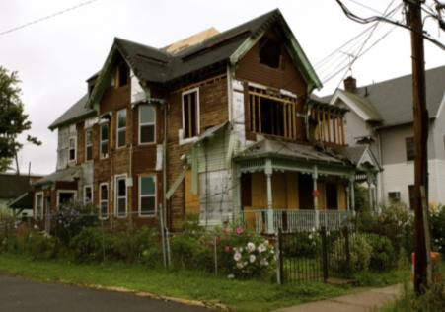
Neighborhoods & Access to Opportunity
Five decades of research indicate that your environment has a profound impact on your access to opportunity and likelihood of success
High poverty areas with poor employment, underperforming schools, distressed housing and public health/safety risks depress life outcomes
  A system of disadvantage
  Many manifestations
    Urban, rural, suburban
People of color are far more likely to live in opportunity deprived neighborhoods and communities
10
Notes:
10

Slide 11
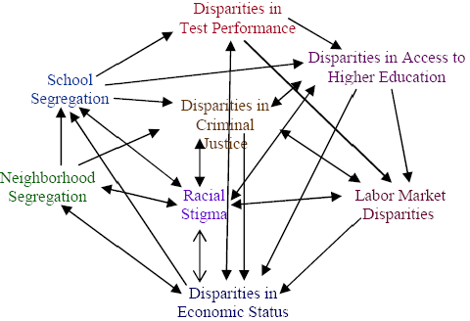
Neighborhoods and Systemic Disadvantage: Interactive
Source: Barbara Reskin. http://faculty.uwashington.edu/reskin/

Slide 12
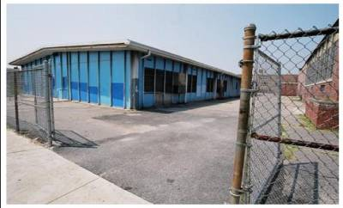
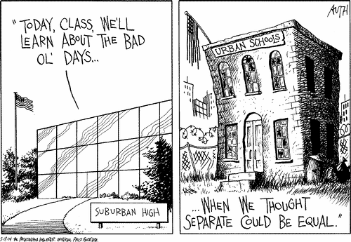
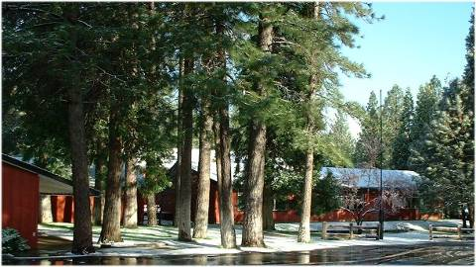
Where children live determine their access to schools….

Slide 13
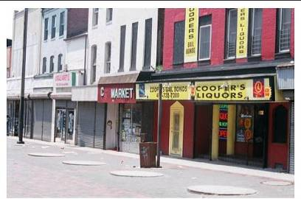

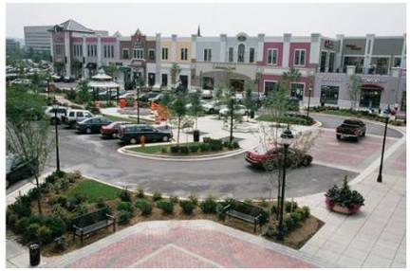
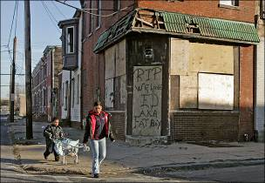
jobs & role models…

Slide 14


bookstores, libraries, and other amenities

Slide 15
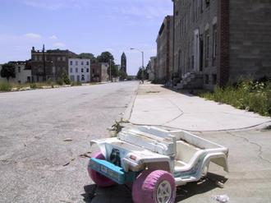

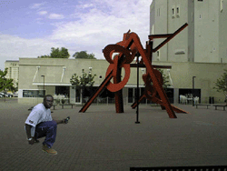
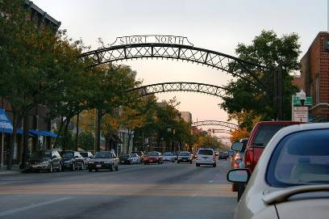
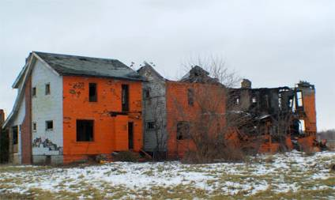
playgrounds, parks, and arts…

Slide 16

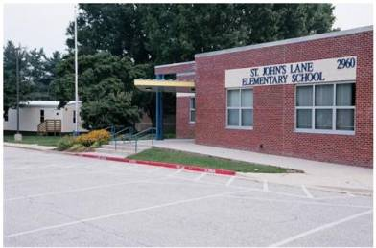


Put these together and you imagine a structure.

Slide 17
Systems Thinking: We are all situated within “opportunity structures”
These structures interact in ways that produce racialized outcomes for different groups, but also in ways that influence identity
Notes:
For a primer on Systems Thinking and Race, see http://4909e99d35cada63e7f757471b7243be73e53e14.gripelements.com/publications/systems_thinking_and_race_primer_july2009.pdf

Slide 18
Cumulative and Mutual:
Cycle of Segregation
School
Segregation
Lower Educational
Outcomes for Urban
School Districts
Neighborhood
(Housing)
Segregation
Increased Flight
of Affluent
Families from
Urban Areas
Notes:
80% of prisoners didn’t complete high school, we spend 8-10x the amount to incarcerate someone

Slide 19

What is Integration?

Slide 20
Confusion in Legal Discourse:
Chief Justice Roberts: “The Constitution is not violated by racial imbalance in our schools.”
Justice Thomas: “Racial imbalance is not segregation, and the mere incantation of terms like resegregation...cannot make up the difference...Integration is merely racial balancing.

Slide 21
Confusion in Civic Discourse:
We no longer think of education as a public, democratic function; it is not viewed as a private and trade function.
We conflate integration with desegregation, diversity, affirmative action…
We ask whether race can be used today or whether we are not a post-racial nation.

Slide 22
Confusion in Educational Discourse:
Schools claim to be integrated when what’s happening is assimilation, in school segregation within the building, or tracking.
We set up excellence and opportunity in competition with integration.
We see integration as something for kids of color, especially black kids.

Slide 23
Defining True Integration
“Although the terms desegregation and integration are often used interchangeably, there is a great deal of difference between the two…Desegregation is eliminative and negative…Integration is the positive acceptance of desegregation and the welcomed participation of [nonwhites] into the total range of human activities. Integration is genuine intergroup, interpersonal doing. Desegregation…is only a short term goal. Integration is the ultimate goal of our national community.”
Martin Luther King, Jr., The Ethical Demands for Integration

Slide 24
Defining Integration in Schools
““Nonwhite segregated schools” are defined as schools with the share of black, Hispanic, or other students of color exceeding 50 percent, or schools with varying combinations of students of color and a share of white students less than 30 percent.”
““Integrated schools” are those with varying shares of black, Hispanic, and other students of color and more than 30 percent white students.”

Slide 25
Voluntary Integration
After decades of integration efforts and hard won gains, many districts throughout the country concerned that the reversion to neighborhood schools and local control would result in rapid resegregation implemented voluntary integration plans.
This refers to integration efforts and strategies that a school system might employ, absent a legal obligation to do so.

Slide 26
Voluntary Integration
School districts around the country, from Boston to Berkeley, implemented voluntary integration plans.
These plans included redrawing attendance zones, student transfers, magnet school programs to retain diverse schools amidst a backdrop of residential segregation.

Slide 27
The Imperative of Integration

Slide 28
The Importance of Integration
Since we constitute ourselves through race, as a set of practices, segregation makes it very difficult to develop effective citizens and social cohesion in our society.
The environment in which we do so matters. Thus, bringing together students from different backgrounds should remain a central objective of American education.
Moreover, in a globalizing world, if we fail at this, our country fails.

Slide 29
Integrated Schools Benefit All Students
•”Students who experience interracial contact in integrated school settings are more likely to live, work, and attend college in more integrated settings.”
•”Interracial contact in desegregated settings decreases racial prejudice among students and facilitates more positive interracial relations.”
•”Integrated schools enhance the cultural competence of white students, preparing them for a more diverse workplace and society.”
http://www.law.umn.edu/uploads/ec/fd/ecfdc6101486f404170847f46b03a083/1-Comprehensive-Strategy-to-Integrate-Twin-Cities-Schools-and-Neighborhoods.pdf

Slide 30
Integrated Schools Benefit All Students
•”Attending racially integrated schools and classrooms improves the academic achievement of minority students, whether measured by test scores, attendance rates, graduation rates, or the likelihood of attending college.”
•Research also shows that integration helps to reduce the achievement gap between students of different racial and ethnic groups.
•Minority students who attended integrated schools tend to choose more lucrative occupations in which minorities are historically underrepresented and to have higher incomes than their peers in segregated schools.
http://www.law.umn.edu/uploads/ec/fd/ecfdc6101486f404170847f46b03a083/1-Comprehensive-Strategy-to-Integrate-Twin-Cities-Schools-and-Neighborhoods.pdf

Slide 31
Beyond Schools: The Benefits of School Integration on Communities
“When implemented on a metro-wide scale:
•School integration can promote residential integration and enhance neighborhood stability, preventing integrated neighborhoods from resegregating.
•Integration efforts can help communities avoid the disinvestment, declining housing values and job losses often associated with economic and racial segregation.
•Revitalization of currently segregated inner city and inner suburb neighborhoods help the entire regional economy.
http://www.law.umn.edu/uploads/ec/fd/ecfdc6101486f404170847f46b03a083/1-Comprehensive-Strategy-to-Integrate-Twin-Cities-Schools-and-Neighborhoods.pdf

Slide 32

Implicit Bias
Learn about how implicit bias
impacts how we
think about integration.
We have made great
progress toward outward
equality, but we still
harbor implicit bias.
Implicit biases can lead
to internal conflict, active
resentment, and unwillingness
to change.

Slide 33
Framing Matters
Talk about academic excellence and integration in new
ways.
It satisfies our need to make sense of the world, particularly when we are conflicted over issues like integration.
How we talk about integration can entrench or uproot and reconfigure policy preferences and attitudes.

Slide 34
Towards Integration

Slide 35
Regional Integration
Segregation affects more than cities. It affects regions. How do you solve this?
Create a regional integration district
What would it need to work?
  Creation of high quality magnets
  Inter-district coordination of district-run magnets
  Establish metro job–centered magnets
  Create pro-integration affordable housing programs in high opportunity neighborhoods
  Race conscious policies and practices of integration
http://www.law.umn.edu/uploads/ec/fd/ecfdc6101486f404170847f46b03a083/1-Comprehensive-Strategy-to-Integrate-Twin-Cities-Schools-and-Neighborhoods.pdf

Slide 36
Example of Inter-District Options
Inter-district magnet schools are one of the remedies that Connecticut adopted in response to a state Supreme Court ruling that the state desegregate schools in the Hartford region. Students are chosen from a lottery of applicants from both Hartford and suburban districts with preference given to siblings of students already attending the school.

Slide 37

For more information, visit: http://www.iupress.indiana.edu/catalog/806639

