Slide 1
IMPLICIT BIAS
Structures
&
Policies
Explicit
Bias
Implicit
Bias
john a. powell
Executive Director
Haas Institute for a Fair and Inclusive Society
March 20, 2014
Health and Racial Equity in Turbulent Times: Implicit Bias Examined

Slide 2
Definitions
Bias – the evaluation of one group and its members relative to another
  Expressed directly/explicitly: “I like whites more than Latinos.”
  Expressed indirectly: E.g., Sitting further away from a Latino than a white individual.
Explicit = Person is aware of his/her evaluation
Implicit = Person doesn’t perceive or endorse evaluation
Source: Unconscious (Implicit) Bias and Health Disparities: Where Do We Go from Here?

Slide 3
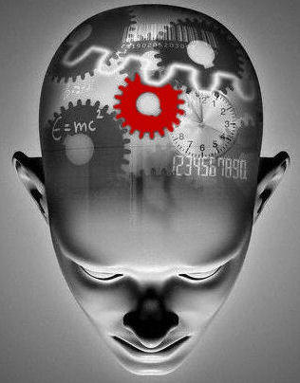
Implicit Bias
  The human brain can take in 11 million pieces of information in any one moment
  We’re only consciously aware
  of maybe 40 of these - at best.
Only 2% of emotional cognition is available to us consciously
Racial bias tends to reside in the unconscious network
Messages can be framed to speak to our unconscious

Slide 4
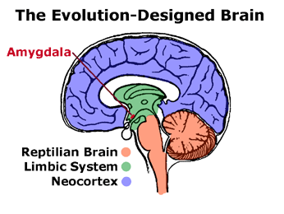
Neurological Origins
Limbic system – categorizes what we perceive
  The limbic system is a
  very old part of the brain;
  it can be found in animals.
  It is also very fast.
One part of the limbic system, the amygdala, is responsible for strong emotional responses (i.e., fight or flight)
The Art of Happiness in a Troubled World. By the Dalai Lama and Howard Cutler. (2009). Graphic - <www.buzzle.com/articles/the-role-of-values-in-wisdom.html>

Slide 5
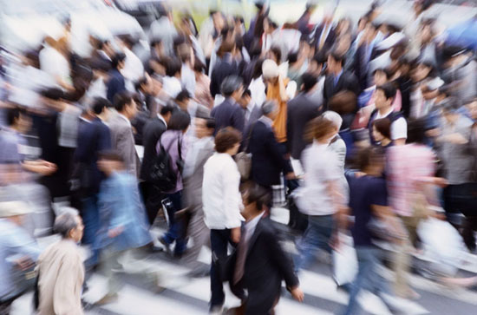
Schemas
They help us organize information into broader categories and conserve mental resources
  objects (e.g., “chairs”)
  behaviors (e.g., “ordering food”)
  human being (e.g., “the elderly”)
  Situational cues
Schemas and the unconscious are social. They exist in and our shaped by our environment.
  Experiences with other people
  Perceptions of structures
  Narratives
    Stories, books, movies, media, and culture
Notes:
Examples of Schemas:
AIRPORTS: We know where to go in new or foreign airports.

Slide 6
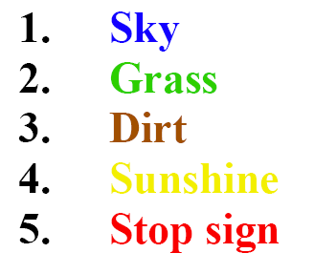
Our Unconscious Networks
What colors are the following lines of text?

Slide 7
Same drill.
What colors are the following lines of text?

Slide 8
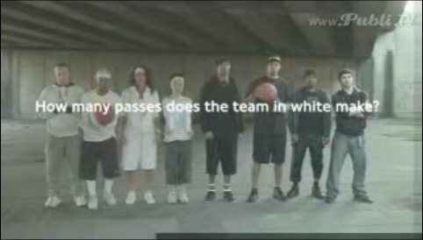
Awareness Test
http://www.youtube.com/watch?v=yrqrkihlw-s
Notes:
Click on the video itself to be taken to the YouTube video.

Slide 9

Internalized Perceptions
We unconsciously think about race even when we do not explicitly discuss it.
You can’t avoid bias by avoiding
race; it does not work.
Conversations about race are not
easy, but they are vital.
Environments & narratives matter
Source: Lester, Julius. Let’s Talk About Race

Slide 10
Identifying & Measuring Implicit Bias
Ask people/Self-Reporting?
  Not reliable or popular in a post-civil rights era
  Subconscious thoughts are outside people’s awareness or conscious thoughts
Physiological
  Increase in heart rate, sweat glands, blood pressure, brain activity
Reaction Time Measurements
  IAT (*will be covered by other panelist)
Experiential
  Consistent disparate outcomes even when controlling for factors

Slide 11
And how do we internalize these perceptions?
High
PITY:
women, elderly, disabled
Your own group, who you identify with
Warmth
DESPISED:
African Americans, Immigrants, Prisoners
Latinos / Latinas?
COMPETENT, but don’t really like them: Asians
Low
Low
Competence
High
Source: Douglas Massey. Categorically Unequal: The American Stratification System. New York: Russell Sage Foundation. 2007.

Slide 12
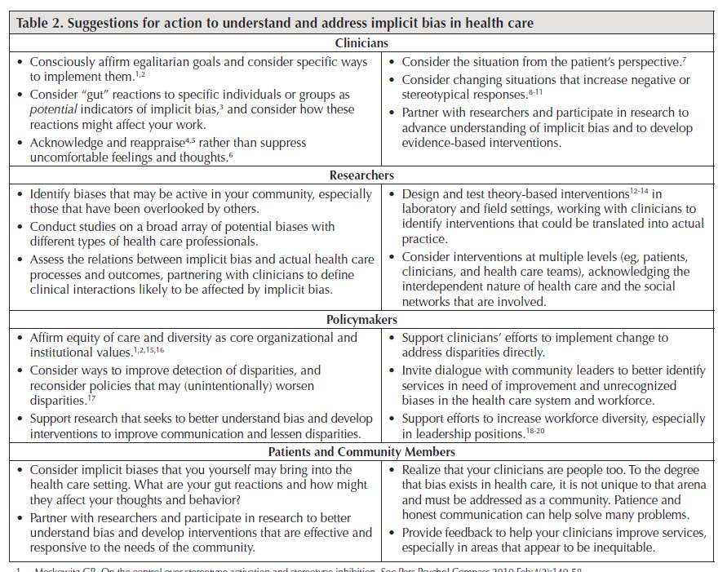
Interpersonal Intervention is Needed…
Source: Unconscious (Implicit) Bias and Health Disparities: Where Do We Go from Here?

Slide 13
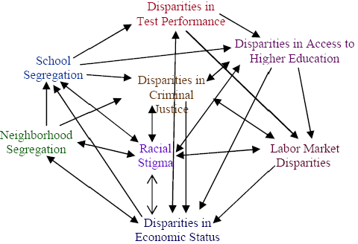
… but it is not enough.
Implicit Bias Interacts with External Structures and Networks
Source: Barbara Reskin. http://faculty.uwashington.edu/reskin/

Slide 14
E.g., Implicit Bias Increases Neighborhood Segregation and Neighborhood Segregation Creates Implicit Bias
Segregation impacts a number of life-opportunities
Impacts on Health
School Segregation
Educational Achievement
Exposure to crime
Transportation limitations and other inequitable public services
Neighborhood Segregation
Job segregation
Racial stigma, other psychological impacts
Community power, civic participation and individual assets
14
Adapted from figure by Barbara Reskin at: http://faculty.washington.edu/reskin/
Notes:
14

Slide 15
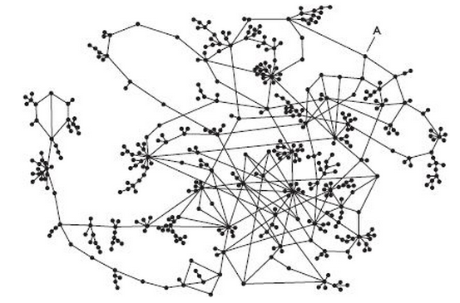

Slide 16
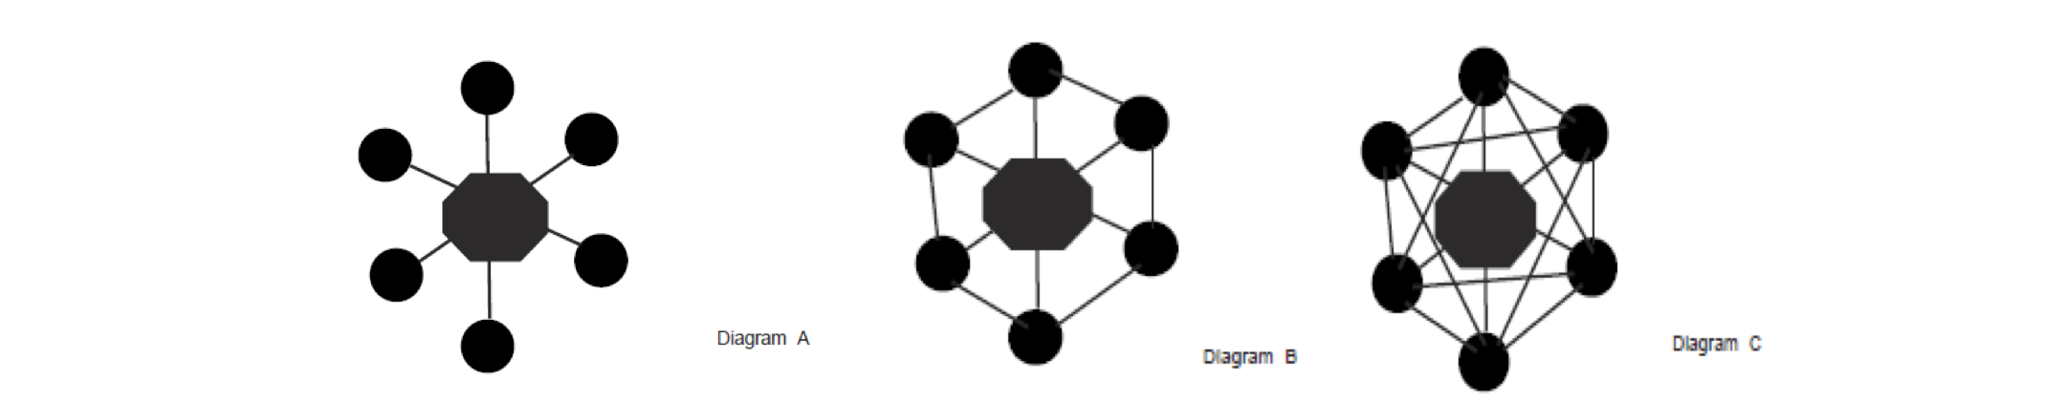

Slide 17
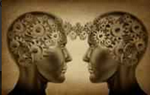
Brain as a network
Our brains are connected to each other

Slide 18
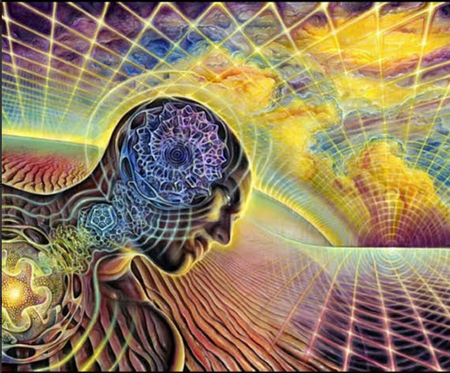
Brain as a network
Our brains are also connected to the environment

Slide 19
Impact
Racialized Outcomes Created Through Interacting Processes
Power
(Organization & Collaboration)
Structural Racialization
Implicit Bias
(Communication)

Slide 20
Interventions Should Account for Interconnectivity and Situatedness
Universal Programs
Targeted Programs
Targeted Universalism
Notes:
The Problem with Race Neutral Policies and Programs:
When purportedly ‘neutral’ programs and policies are overlaid on already racialized practices, norms, and institutional arrangements, it is likely to not only leave such arrangements undisturbed, but perpetuate and exacerbate them
20

Slide 21
Targeted Universalism
Structural Inequity produces consistently different outcomes for different communities.
Targeted Universalism responds with universal goals and targeted solutions
VS.
Structural Inequity
Targeted Universalism
©2012 Connie Cagampang Heller
Notes:
When purportedly neutral strategies or programs and policies are overlaid on already unequal practices, norms, and institutional arrangements, it is likely to not only leave such arrangements undisturbed, but perpetuate and exacerbate them
Targeted universalism is a differentiated means for achieving the goal of a healthy society for all
A model where we embrace collective, yet differentiated solutions
A model where we all grow together
This vision requires collective action and coalitions

Slide 22
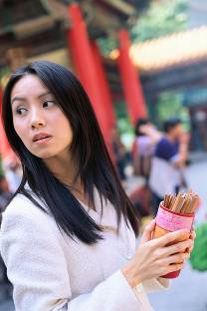
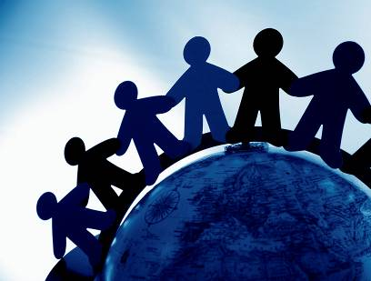
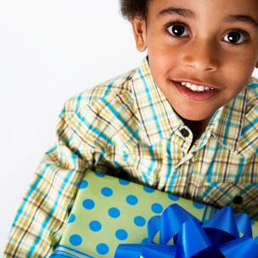
Linked Fates
“We are all caught up in an inescapable network of mutuality, tied in a single garment of destiny. Whatever effects one directly effects all indirectly.”
-The Rev. Dr. Martin Luther King, Jr.
Notes:
Our fates are linked even though they have been socially constructed as disconnected

Slide 23
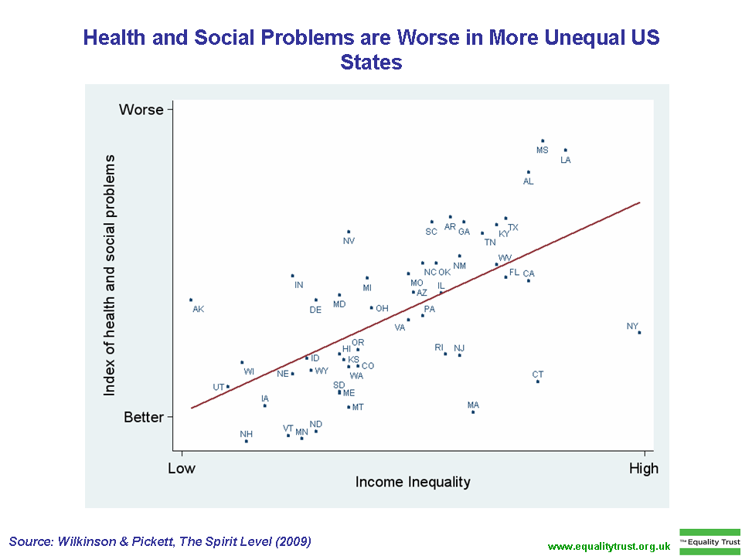
Illustrating the Problem
of Inequality for All

Slide 24
Must Expand the Circle of Human Concern
Segregated and
isolated groups
Citizens
Felons
Elderly
Mothers
Children
Undocumented
Immigrants
Non-public/non-private Space: African Americans/Latinos

Slide 25
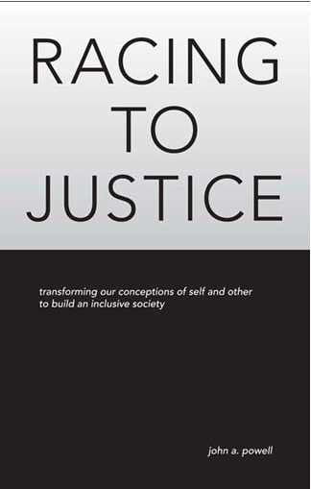
For more information, visit: http://www.iupress.indiana.edu/catalog/806639

Slide 26

Local and Regional Government
alliance on
race & Equity
Institutional / Explicit
Policies which explicitly discriminate against a group.
Example:
Police department refusing to hire people of color.
Policies that negatively impact one group unintentionally.
Example:
Police department focusing on street-level drug arrests.
Individual / Explicit
Individual / Implicit
Prejudice in action – discrimination.
Example:
Police officer calling someone an ethnic slur while arresting them.
Unconscious attitudes and beliefs.
Example:
Police officer calling for back-up more often when stopping a person of color.
Institutional / Implicit

