Slide 1
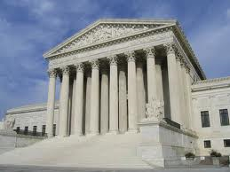

Fisher v. Texas and the Future of Affirmative Action
Stephen Menendian,
Assistant Director,
Haas Diversity Research Center (HDRC)
September 18, 2012

Slide 2
Overview
The Facts of Fisher v. Texas
The Importance of Race-Conscious Admissions
A Brief History of Race-Conscious Admissions
Possible Outcomes in Fisher
Post-Fisher Advocacy

Slide 3

Fisher v. Texas
The Future of Affirmative Action

Slide 4
The Facts
Abigail Fisher, a white female, was denied admission to the University of Texas, and did not qualify for automatic admissions under the 10% Law.
The University of Texas has two admissions pools:
  Individuals automatically admitted through the 10% law
  A holistic admissions procedure that looks at the race of the individual applicant (ala Grutter).

Slide 5

The Texas-Ten Percent Plan
Guarantees admission to the University of Texas – the state’s flagship university -- for every student who graduates in the top 10% of their graduating class.
Relies on patterns of residential segregation to generate diversity.
Caused a split between conservative rural representatives and conservative suburban legislators.
  Some counties in West Texas had never sent a high school graduate to the University of Texas.

Slide 6
Fisher v. Texas
Ms. Fisher sued Texas arguing that the use of race in undergraduate admissions violates the equal protection clause of the 14th Amendment.
  She argues she had better credentials than minority applicants that were admitted.
  She also argues that the success of the 10% plan in generating student body diversity at UT renders the additional race-conscious procedure unnecessary.

Slide 7
UT Enrollment v. State Demographics
Race | University of Texas | State Demographics
White, Non-Hispanic | 50.4% | 45.3%
Asian | 17.9% | 4.4%
Hispanic/Latino | 20.0% | 37.6%
Black | 4.6% | 12.6%

Slide 8

The Importance of Race-Conscious Admissions

Slide 9

Education
Education is one of the most important conduits of opportunity.
This is far more true today than in 1954, when the Supreme Court said:
Education is a principal instrument in awakening the child to cultural values, in preparing him for later professional training, and in helping him to adjust normally to his environment. In these days, it is doubtful that any child may reasonably be expected to succeed in life if he is denied the opportunity of an education.

Slide 10
And yet…
  Almost 1 in 6 black and Latino students are hyper-segregated, and attend schools in which the student body is 99-100% minority.
  Nearly 40% of black and Latino students attend ‘intensely segregated schools,’ in which 90-100% of the students are minority.
  Whites are the most isolated group of students. The typical white student attends a school that is 80% white, which is much higher than their share of overall public school enrollment.

Slide 11
Disparities in Higher Ed
  in 2003, white college students received 70% of college degrees.
    Black students earned 8.7% of college degrees that year, despite being 13% of the population
    Rates of 6.3 for Hispanics, and 6.2% for Asians.
  74% of the students at the 146 most selective 4-year colleges and universities in the US come from the top SES quarter of American families, compared to only 3% who come from the bottom quarter.

Slide 12
Race and Concentrated Poverty
    There is a profound relationship between poverty and racial segregation that particularly harms students of color.
      Only 1/5 of the schools with less than 10% black or Latino populations are high poverty schools.
  3 of 4 persons living in concentrated poverty are Black or Latino even there are more poor whites in absolute numbers.
  No wonder there is a pipeline problem…

Slide 13

Testocracy
Standardized tests do not measure intelligence. They measure developed skills.
Standardized Tests like SAT, LSAT, etc are poor predictors of student performance.
Standardized tests measure family, and especially intergenerational wealth.
  If you want to admit upper-middle class white students, you should use standardized tests in admissions. SAT is a boost for these students.

Slide 14
The Courage of Kelley Williams-Bolar

Slide 15

Universities, and in particular, law schools, represent the training ground for a large number of our Nation’s leaders.
Justice O’Connor
In order to cultivate a set of leaders with legitimacy in the eyes of the citizenry, it is necessary that the path to leadership be visibly open to talented and qualified individuals of every race and ethnicity.
….so that all members of our heterogeneous society may participate in the educational institutions that provide the training and education necessary to succeed in America.

Slide 16

Challenges to Diversity
Diversity often comes under attack as an assault on merit, as measured or conceived of largely by standardized tests.
Individual merit focuses on using these past achievements as predictors of future success
The graduates at the University of Michigan Law School who are most likely to fulfill the educational mission of the University – doing public service, mentoring younger attorneys, serving on community boards -- were the black and Latino beneficiaries of affirmative action.

Slide 17
Testocratic Versus Democratic Merit
Testocratic Merit
  Focuses on past achievement
  Relies on “objective” measures (GPA, ACT/SAT scores, etc.)
  Fails to account for life challenges.
Democratic Merit
  Invests in potential
  Considers how students may contribute to society
  Group-level focus

Slide 18
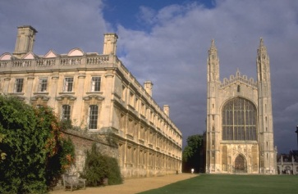
A Brief History of Race-Conscious Admissions

Slide 19
Regents of the University of California v. Bakke (1978)
Allan Bakke, a white male, applied to Medical School of the University of California Davis, and was rejected.
UC Davis had two admissions tracks: general admissions and special admissions for disadvantaged students of a “minority group.”
  The special admissions committee set aside 16 of 100 seats.
Allan Bakke sued arguing that but for the special admissions track, he would have been admitted.

Slide 20
The Court:
Struck down the plan as a violation of the EPC, holding that:
All racial classifications are subject to strict scrutiny.
Remedying Societal Discrimination is not a compelling interest to justify the use of race.
HOWEVER: Ethnic/racial diversity is one element in a range of factors a university properly may consider in attaining the goal of a heterogeneous student body.

Slide 21
What is Strict Scrutiny?
Strict Scrutiny is a legal standard and a two pronged test. It is the highest level of judicial scrutiny for constitutional review.
To satisfy this standard, racial classifications are constitutional only if they:
  Serve a compelling governmental interest AND
  Are narrowly tailored to serve that interest.

Slide 22
Why Strict Scrutiny?
Strict Scrutiny serves two primary goals:
  A “Smoking Out” Function: strict judicial scrutiny permits an inquiry into the interests at issue, without presuming a benign motive.
  Cost/Benefit Function: The EPC protects individuals, not groups. Strict Scrutiny balances the government interests with the costs to individuals.
Strict Scrutiny is not ‘strict in theory, but fatal in fact.’
Context matters: Court must take relevant differences into account in applying SS.

Slide 23
Gratz v. Bollinger
539 U.S. 244 (2003)

Slide 24
Gratz v. Bollinger (2003)
Petitioners, both of whom were Michigan residents and Caucasian, applied for admissions to the University of Michigan’s College of Literature, Science, and Arts, and were denied admission.
Applicants were awarded 20 point (on a 150 point scale) based upon membership in an underrepresented minority group.
Petitioners filed suit alleging discrimination on the basis of race in violation of the EPC and Title VI.

Slide 25
The Court held...
Struck down the admissions plan because:
The 20 point bonus undermined individual consideration since any minimally qualified applicant would then be automatically accepted (having crossed the 100 point threshold).
The 20 points were awarded solely on one consideration: membership in an under-represented minority group.
Being automatically admitted precludes consideration of other individual characteristics.

Slide 26
Grutter v. Bollinger (2003)
Barbara Grutter applied to and was rejected from the University of Michigan law school. She filed suit alleging that the law school discriminated against her on the basis of race.
She argued that the law school used race as a ‘predominant factor’ in admissions, giving minority applicants with similar credentials a significantly greater chance of admission.

Slide 27
The Court held that:
The University of Michigan Law School had a compelling government interest in attaining a diverse student body.
The admissions program was narrowly tailored to serve the compelling interest in obtaining the benefits that flow from a diverse student body, and thus did not violate the EPC.

Slide 28
What was the Court’s reasoning?
The Court found that the benefits from diversity are substantial:
  Breaking down racial stereotypes
  Promote cross-racial understanding
  Livelier, more spirited, and enlightening classroom discussion when students have varied backgrounds.
  Studies show that student body diversity promotes learning outcomes
  And better prepares students for increasingly diverse workforce and professional life (Brief for US military and GM cited here)
  Preparing students for citizenship, where education ‘sustains our political and cultural heritage,” and maintains the fabric of society.

Slide 29
Narrow Tailoring Requirements
The Court identifies five narrow tailoring requirements for race-conscious admissions programs:
The program cannot use a “quota” – it cannot insulate any category of applicants from competition or consideration with others.
Race cannot be a defining feature of an applicant’s application: individualized, holistic review must be given.
Serious, good faith consideration of workable race-neutral alternatives.
No undue harm to any member of any racial group.
Time Limited

Slide 30
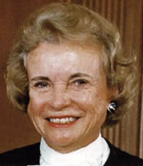
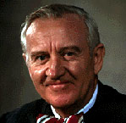
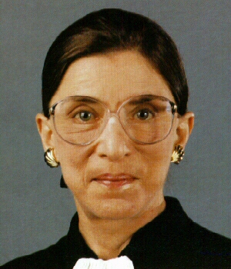
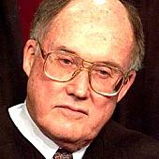
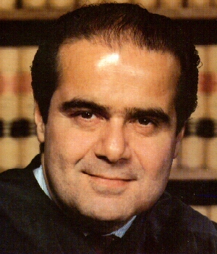
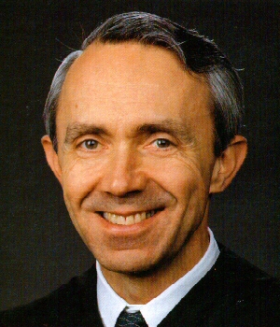
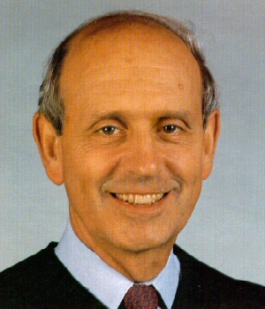
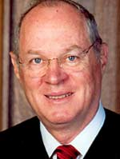
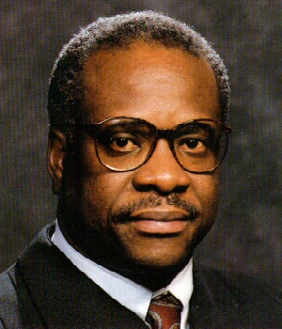
Grutter and Gratz

Slide 31

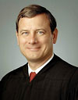
Changing Composition of the Court: Justice Kennedy is the Critical Vote

Slide 32
Justice Kennedy’s
Dissent in Grutter
“The opinion by Justice Powell, in my view, states the correct rule…for the Court’s acceptance of a university’s considered judgment that racial diversity among students can further its educational task.”
“Diversity can be accepted based on empirical data known to us, but deference is not to be given with respect to the methods by which it is pursued. The narrow fluctuation band raises an inference that the Law School subverted individual determination, and strict scrutiny requires the Law School to overcome the inference.”

Slide 33
J. Kennedy, Concurring in PICS
The enduring hope is that race should not matter; the reality is that it too often does. To the extent that the plurality opinion suggests the Constitution mandates that state and local school authorities must accept the status quo of racial isolation, it is, in my view, profoundly mistaken
In the administration of public schools by the state and local authorities, it is permissible to consider the racial makeup of schools and to adopt general policies to encourage a diverse student body, one aspect of which is its racial composition.

Slide 34
Justice Kennedy, Concurring
The Nation has a moral and ethical obligation to fulfill its historic commitment to creating an integrated society that ensures equal opportunity for all its children. A compelling interest exists in avoiding racial isolation, an interest that a school district, in its discretion and experience, may choose to pursue.
Due to a variety of factors – some influenced by government, some not – neighborhoods in our communities do not reflect the diversity of our Nation as a whole. Those entrusted with directing our public schools can bring to bear the creativity of experts, parents, administrators, and other concerned citizens to find a way to achieve the compelling government interests they face…

Slide 35

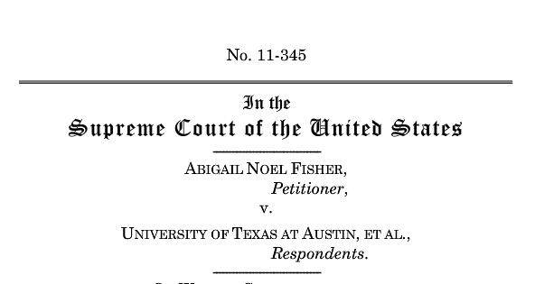
Possible Outcomes in Fisher v. Texas

Slide 36
Possible Outcomes:
Worst Case Scenario: The Court overturns Grutter, striking down UT’s admissions policy.
Splitting the Difference: The Court Overturns the UT Plan, but Under the Grutter/Bakke Standard
Best Case Scenario: The Court Upholds the UT Admissions Policy

Slide 37
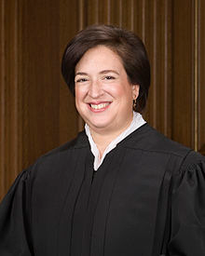
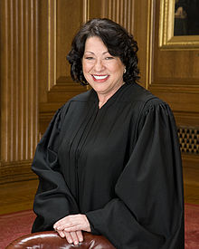
The Fisher Court

Slide 38
Justice Kennedy is Key
Justice Kennedy dissented in Grutter, but agreed with Justice O’Connor’s opinion that promoting diversity in higher education is a compelling governmental interest that justifies the use of race in admissions.
However, Justice Kennedy (as in Grutter) is likely to hold that the UT plan is NOT narrowly tailored.

Slide 39

Oral Argument – Oct. 10, 2012
What we might learn at oral argument:
  Where the Justices stand on this issue
  How the Court is likely to rule
  The standard they might employ for race-based admissions

Slide 40
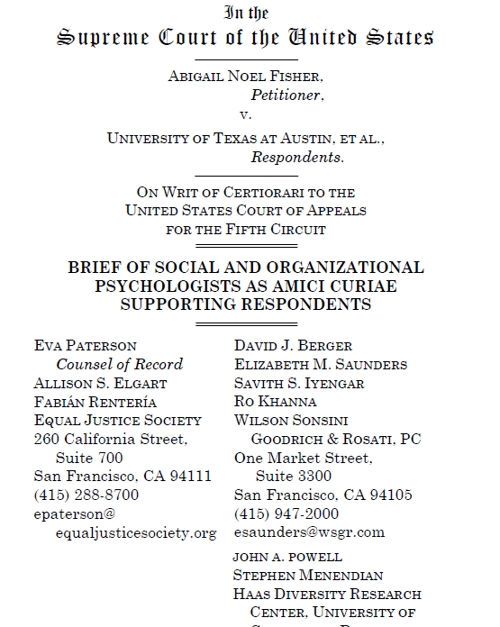
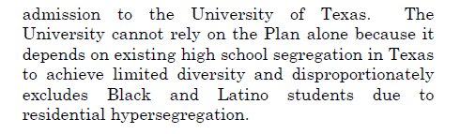
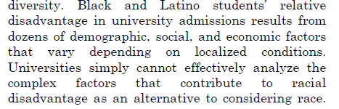
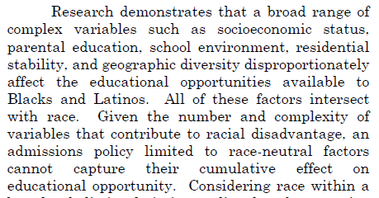
What we argued…

Slide 41
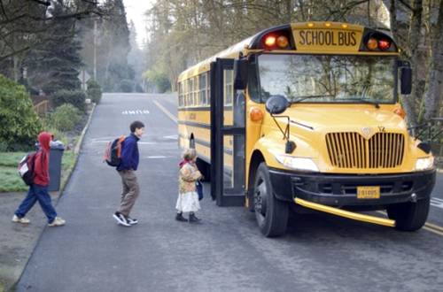
Post-Fisher Possibilities

Slide 42
Post-Fisher Planning
Post-Fisher planning will depend on possible outcomes.
If the Court upholds UT’s plan, then Universities can rely on race-based admissions policies with greater confidence.
However, if the Court either strikes down the plan under Grutter or overturns Grutter…

Slide 43
Post-Fisher Possibilities:
Geographic diversity
Socio-economic diversity
Preference for racially isolated school applicants
Diversity capital
Opportunity Enrollment
Targeted recruitment from minority schools
Reduce reliance on SAT/ACT

Slide 44
Post-Fisher options:
Look at “distances traveled” (U. Mich Plan)
Ask Universities to set a preference for students that reside in high non-white census tracts, zip codes, or attend high non-white high schools.
Set a quota for enrolling students from low and very low opportunity census tracts.

